Slide 1
Town and Parish Council Training
How to frame a consultation response

Slide 2
Site Location Plan
Scheme of Delegation
All planning application decisions including decisions concerning Environmental Impact Assessment (EIA) decisions or considerations requiring Habitat Regulation Impact Assessments (HRA)are delegated to Head of Planning and Coastal Management UNLESS:
1. The Planning Application is, in the opinion of the Head of Planning and Coastal Management and/or the Chair and Vice Chair of the Planning Committee, of significant public interest; would have a significant impact on the environment; or should otherwise be referred to Members due to its significance in some other respect; or
The applicant or landowner is East Suffolk Council;
The applicant, or agent, is an East Suffolk Councillor or an East Suffolk Council employee, or the applicant, or agent, is a close relative of an East Suffolk Councillor or East Suffolk Council employee; or
The referral process is triggered (see next slide) –
In which case, if item 4 is invoked, the Planning Application will be referred to the Referral Panel – the panel will discuss with the Head of Planning and Coastal Management (based on planning grounds) to either refer the application to Planning Committee for decision or remain delegated to the Head of Planning and Coastal Management.

Slide 3
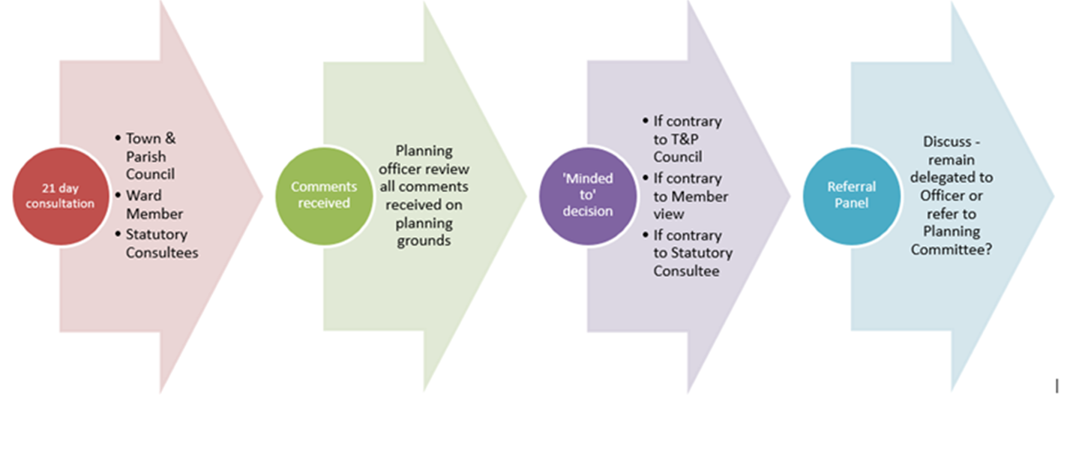
Referral Process

Slide 4
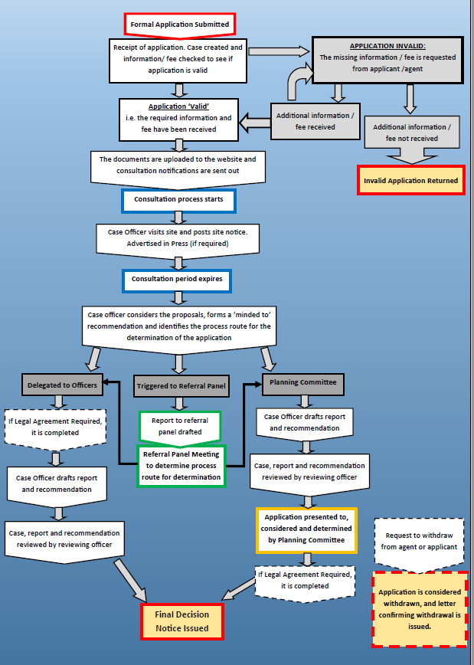
The life of a planning application
This table details all the processes necessary to consider and determine a planning application. In terms of timescales, the determination date for major applications is 13 weeks and is 8 weeks in all other instances

Slide 5
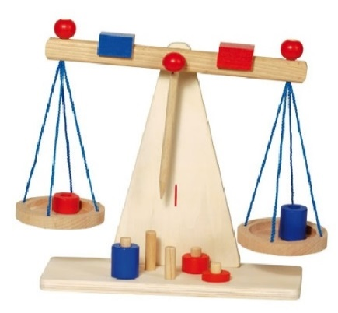
Material Planning Considerations
What they are and are not - decided by statements of national policy or by decisions of the courts
The weight that should be attached to each consideration in any particular case is for the decision maker.
Notes:
So remembering that “……have regard to the provisions of the development plan, so far as material to the application, and to any other material considerations”.
What are those material considerations?

Slide 6
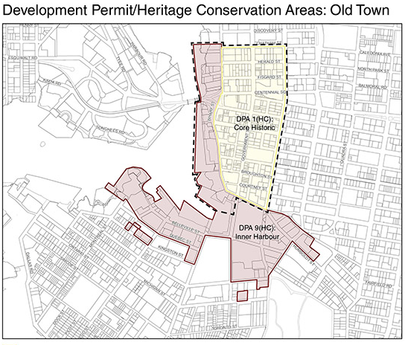
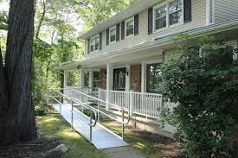
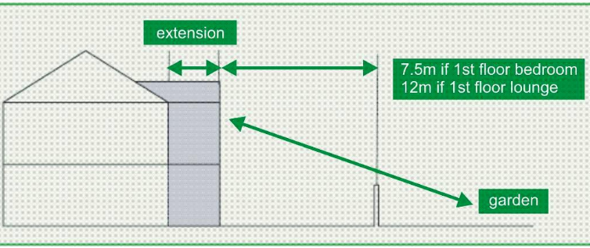
Material Planning Considerations (e.g.s)
Overlooking / loss privacy
Loss of light / overshadowing
Effect on listed building
Layout, density
Policies in the Development Plan
(including Local Plan and Neighbourhood Plan)
Previous decisions/appeals/court cases
Nature conservation and Ecology
Parking
Highway safety
Traffic
Noise
Design, materials
Govt. policy

Slide 7

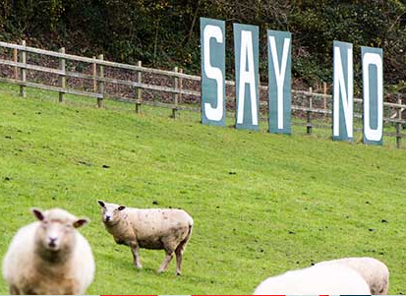
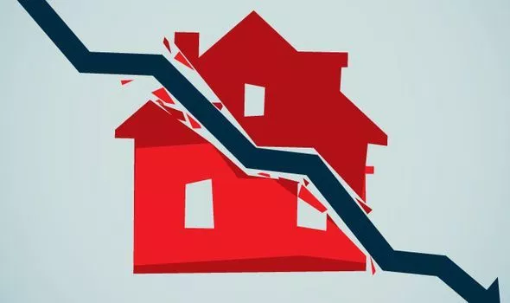
Non-material Considerations
These include:
  Loss of private view (i.e. from a window in a house or garden)
  Negative (or positive) effect on the value of properties
  Land ownership or restrictive covenants
  Applicant’s personal circumstances (unless exceptional such as relating to a physical disability), ie nightshift working
  Business competition
  Too many already
  Damage to property fears
  Disturbance during building works
  Other matters controlled under building regulations or other non-planning legislation
Notes:
it is not the number of objections, but the evidence in support of the planning reasons for objection, that is the material consideration.

Slide 8
What should I include in my comments?
Comments on applications should be made in writing to planning@eastsuffolk.gov.uk within the specified timeframe
You should include:
The application reference number (this will be in the form DC/20/****/***
The address of the application,
Your contact details,
Whether you:
  object (i.e. are against the scheme),
  have no objections (you wish to make comments but do not object or support)
or
  support the scheme (i.e. you are in favour).
and
Your specific views/comments on the proposals referring to material considerations (see overleaf).

Slide 9
It is important that the response is clear on the stance and raises material considerations to enable a greater chance of the referral process being triggered and called to committee.
If comments do not have a clear stance then they leave open ambiguity and may leave your comment as being neutral.
If the item is passed to the Referral Panel, then the Panel will look at what planning reasons there are for debating the matter round the Committee table.
A response saying – “we object” or “we support” will reduce any change of the matter being referred. Likewise raising non-material considerations will also weaken the Town or Parish Council’s position. We would suggest therefore that all formal responses are qualified by appropriate supporting text.

Slide 10
The following slides provide some examples of cases outside of East Suffolk Council.
Although there are references to policies it is not necessary that you are aware of their exact text as it is the principles you are looking at and suggestions on how a response could be worded.

Slide 11
Example One
one new dwelling

Slide 12
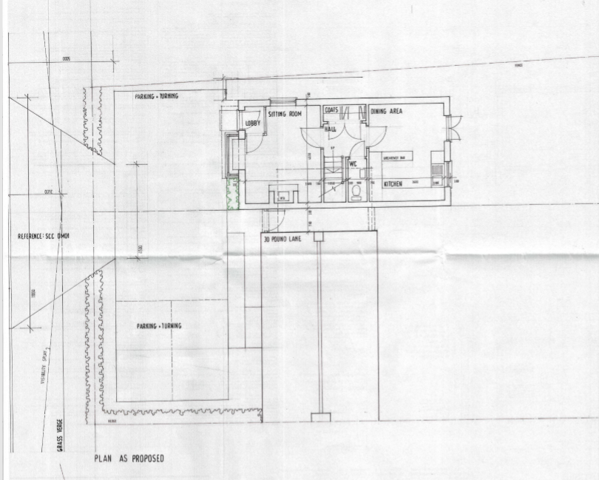
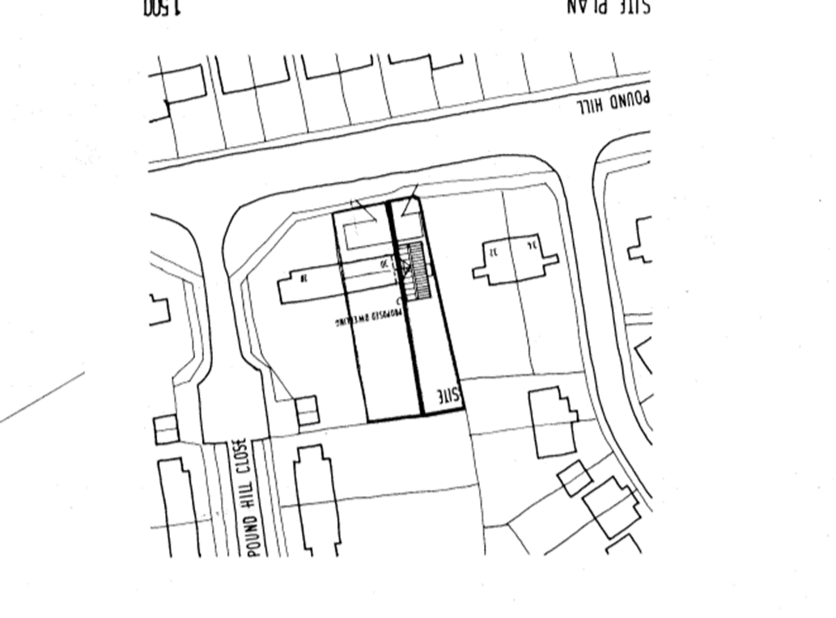
Example One – one new dwelling

Slide 13
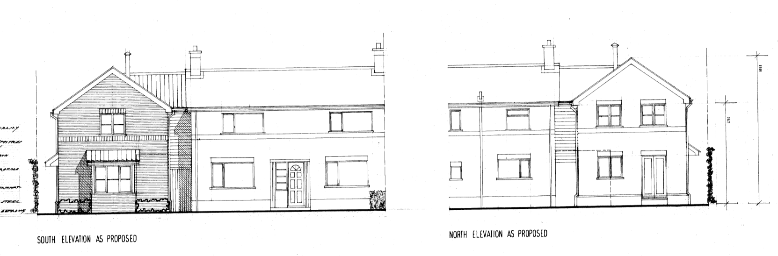

Slide 14
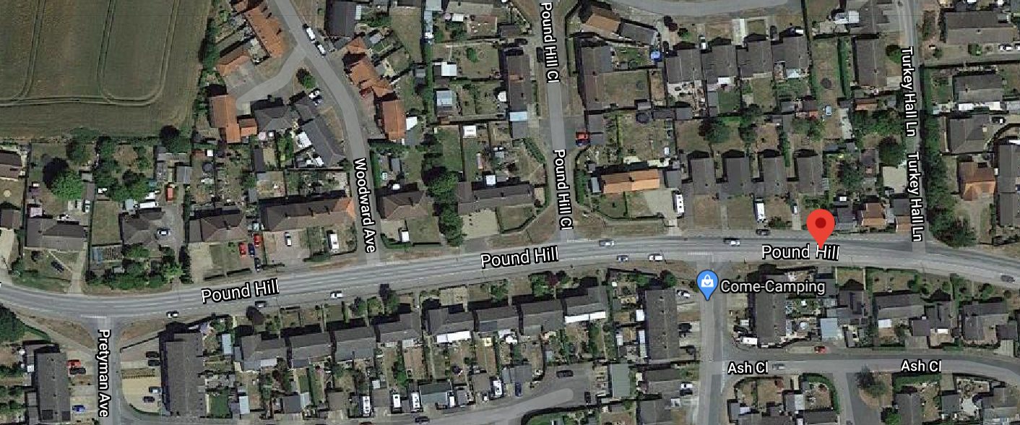

Slide 15
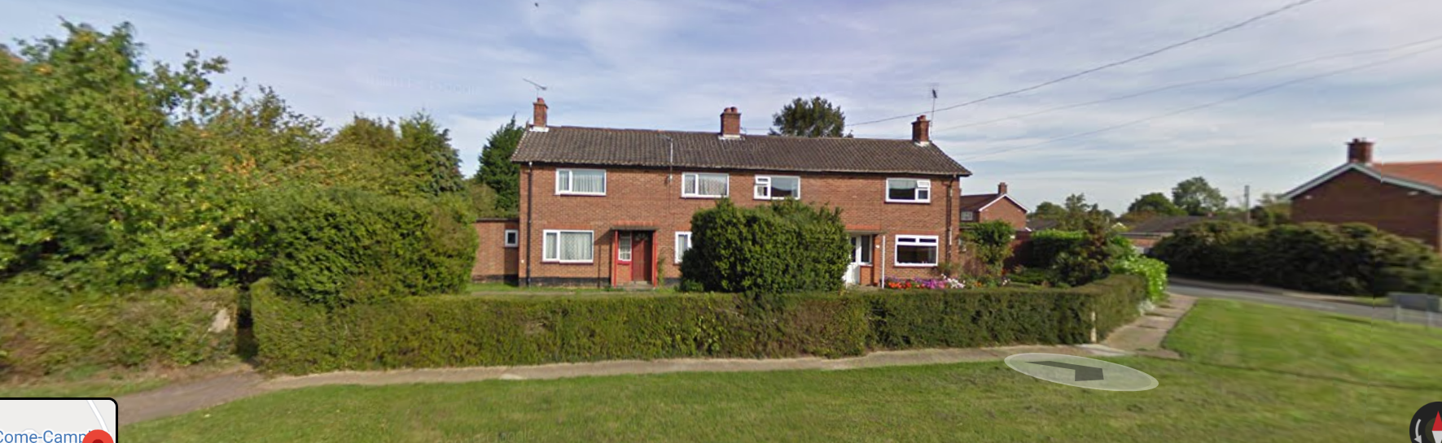

Slide 16
What issues could you raise in either support or against the application?
What material planning matters do you think are engaged in this application?
Parish Council Response
Erection of detached dwelling and formation of vehicular access from Pound Hill serving new dwelling at 30 Pound Hill, Bacton IP14 4LP. After careful consideration and much discussion, the council have agreed to send the following response: It would appear that due to the roof line drawing planning policy GP1 has not been met. With the amendment to the original plans it would seem that a clear window is overlooking a neighbouring property which would appear to contravene planning policy SB2.
Is this a good response?
No formal stance recorded but they have referenced policy and material matters. I would suggest a formal object or support would help the Council better understand their view.

Slide 17
Example 2
DC/17/05423 | Outline planning application (all matters reserved except access) for development of up to 81 dwellings. | Land To The North Of Church Road Bacton Suffolk

Slide 18
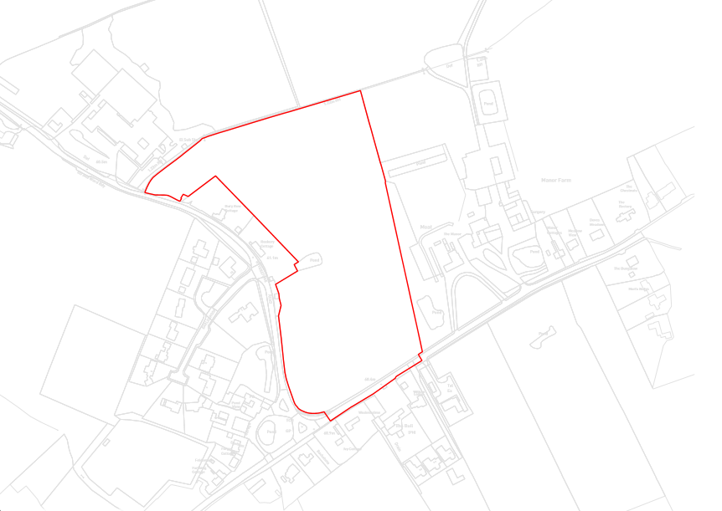

DC/17/05423 | Outline planning application (all matters reserved except access) for development of up to 81 dwellings. | Land To The North Of Church Road Bacton Suffolk
denotes listed building

Slide 19
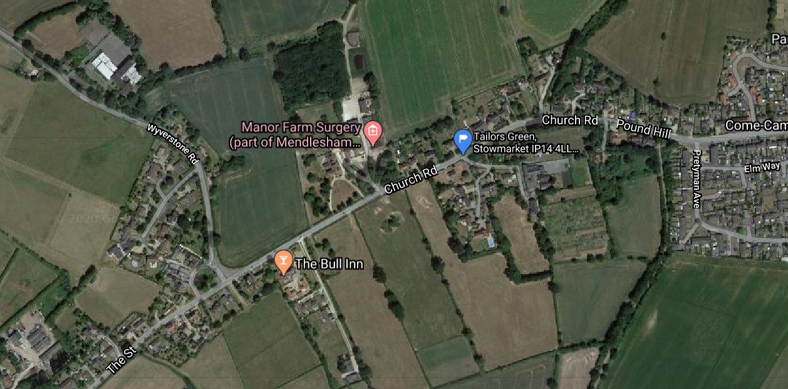

Slide 20
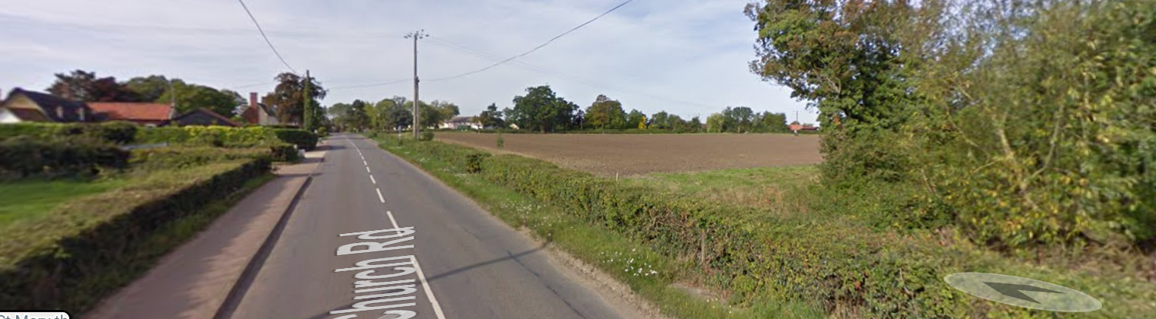
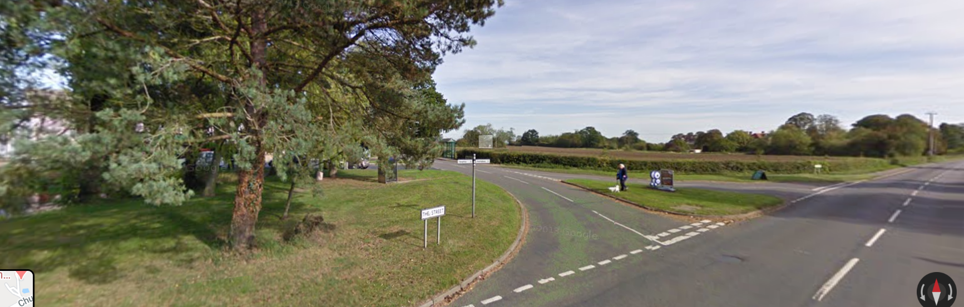

Slide 21
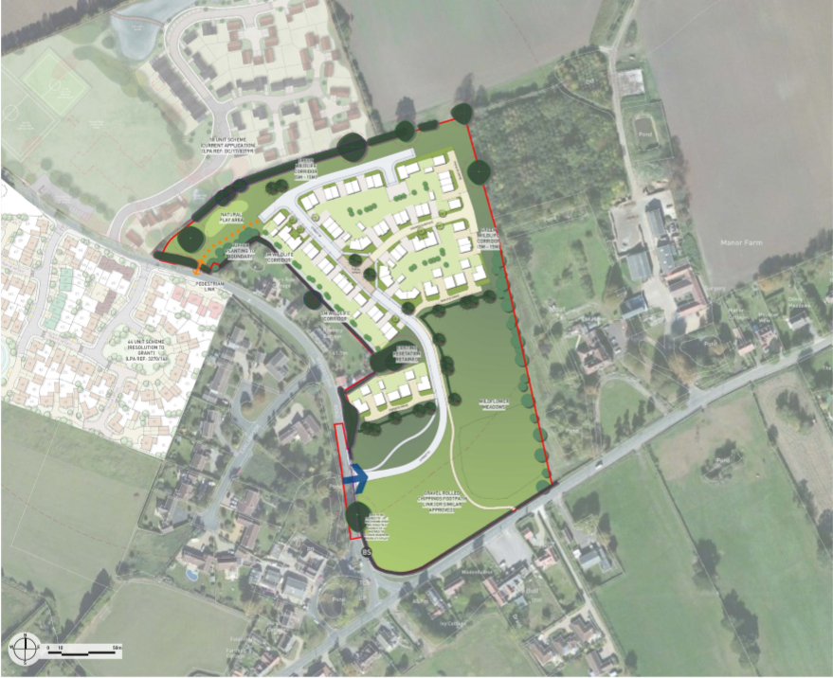

Slide 22

What issues could you raise in either support or against the application?
What material planning matters do you think are engaged in this application?
Parish Response
How could this response be improved?
What are their material issues on the application – referencing a policy on its own does not highlight what the real concerns are.

Slide 23
Example 3
single storey side extension

Slide 24
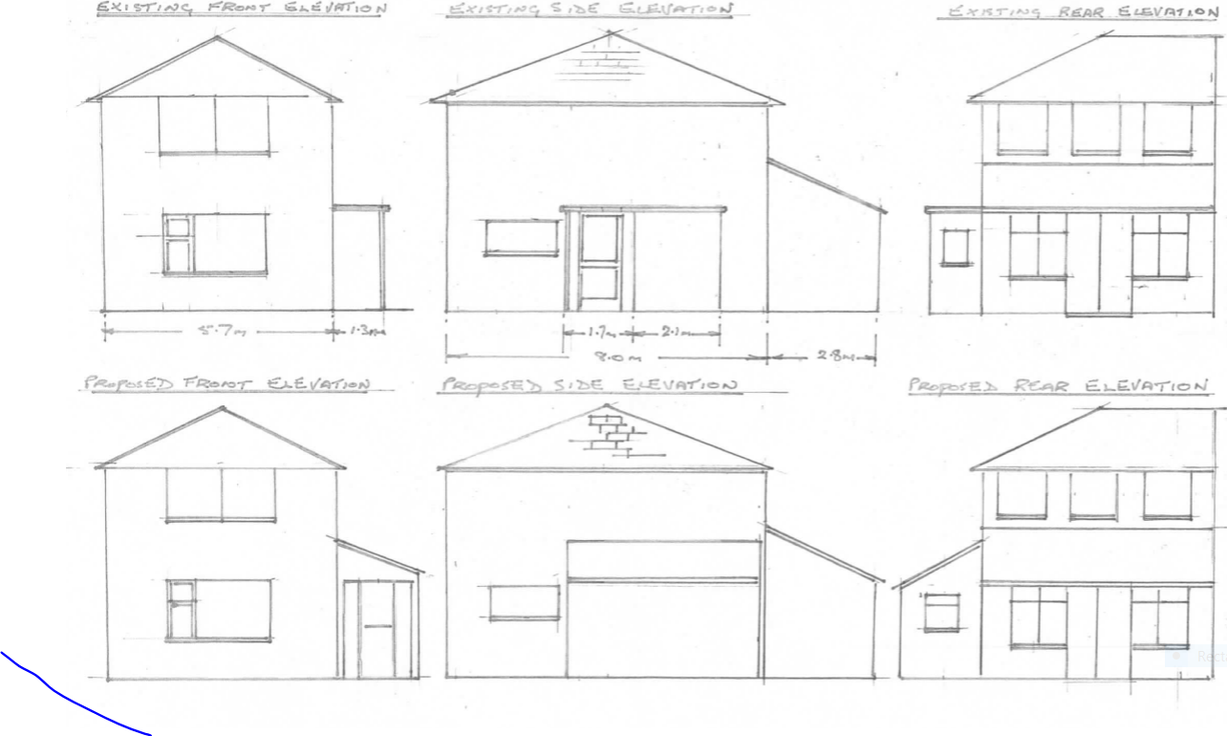
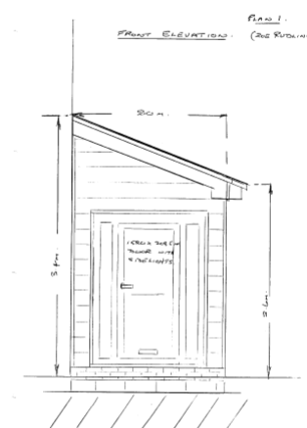

Slide 25
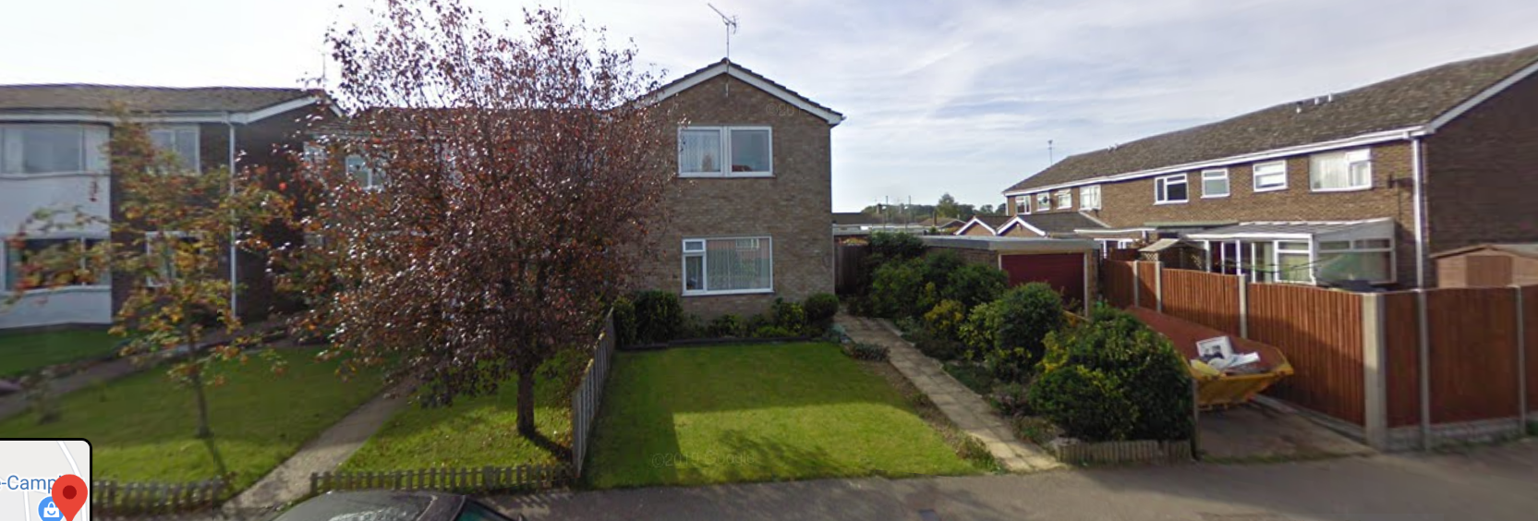

Slide 26
What issues could you raise in either support or against the application?
What material considerations are engaged in this application?
Parish Council response
DC/18/02391 Erection of single storey extension 59 Pound Hill Bacton Stowmarket IP14 4LP. After careful consideration the Council agreed to SUPPORT this application. This decision was based on planning policy GP1; materials should respect local architectural styles, proposals should maintain or enhance the character and appearance of their surroundings.
Could the response be improved?
It does what it says on the tin

Slide 27
Examples of other responses which are good examples:
DC/18/02391 Erection of single storey extension 59 Pound Hill Bacton Stowmarket IP14 4LP. After careful consideration the Council agreed to SUPPORT this application. This decision was based on planning policy GP1; materials should respect local architectural styles, proposals should maintain or enhance the character and appearance of their surroundings. DC/18/02803 Erection of 1 no. dwelling 42 Pound Hill Bacton Stowmarket IP14 4LP. The Council resolved to SUPPORT this application based on policies GP1 and SB2: Within settlement boundaries developments appropriate to their surrounding will normally be permitted. This application is in keeping with the surroundings.
DC/18/02738 Outline planning application (some matters reserved) Erection of 1 no. detached property with garage and access The Croft Earls Green Road Bacton Stowmarket Suffolk IP14 4SA. The Council agreed to SUPPORT this application quoting policies GP1 and SB2: The proposed application would enhance the character of the surroundings and respects the scale and density of the area. It does not effect the privacy and amenity of neighbouring properties.

Slide 28
Examples of other responses which are poor examples:
The Parish Council supports the application. – there is no reason to support the proposal. The Council could say that the proposal sits well in the steetscene, is a visual enhancement, meets identified housing need etc
The Parish Council objects to the application. – why does the Council object? What grounds are there for the officers to look for amendments or the referral panel to take the matter to committee.
The Parish Council raises concerns over the impact on property values – the stance is neutral as it states ‘concern’ rather than ‘object’ and also raises non material considerations which cannot be considered in the planning process.

